Slide 1
Online Bakery Management System
CMT 400 : Research Project Progress Report
Name : Jane Karuga| REG. Num: 1040477
Supervisor: Michael Kinyua

Slide 2
[Notes on slides; Delete or hide this slide]
Only minimal text is expected on the slides
The audience of your presentation is the panel. The panel only needs slides to guide them through your oral presentation. If you need extra notes, use the notes view (view menu/ notes page) to hide them from the audience but make them available to the presenter/yourself during the presentation]
Use a bulleted list or numbered list in your slides. Don’t use continuous prose
The projector screen is for the panel, your screen is the laptop screen, make use of it unless it becomes necessary to point at something on the audience screen that the mouse pointer can’t effectively do from your screen.
Rehearsing your presentation minimizes stage fright.
Delete all placeholder content in the other slides, that is, content in [square brackets].
The panel will check on your research problem, objectives, analysis and design. You will also present the actual incomplete system as guided by your supervisor.

Slide 3
Content
Background of the Research
Problem Statement
Main & Specific Objectives
Analysis
Design
Implementation

Slide 4
Background of the research
With the current advances in technology, bakeries need to embrace adaptability to the new area of digitization in order to keep up with the competitive game in their industries.
This does not only limit to large businesses but also small businesses that have a goal for growth in their business. This includes introduction to Online Bakery Management Systems to the local retail bakeries so that customers can have an easy access to book online for their cakes and pastries and also the store can have an efficient way of managing their customers from their end and be well prepared even for their busy days.

Slide 5
Main & Specific Objectives
Main Objective: To design and develop an Online Bakery Management System that will enhance customer outreach for small scale bakery businesses in Kenya.
Specific Objectives:
To determine user requirements for the envisioned system.
To develop conceptual and technical designs based on the user requirements.
To implement the designed system using appropriate programming languages and technologies.
To execute testing procedures so as to identify and address any defects or discrepancies of the developed system.

Slide 6
Analysis(1)
Functional requirements
User Interaction: User Registration, Admin Registration.
Placing of orders by the customer successfully.
Bakery owner(admin) to update the menu with ease, which includes Creation, Update and Deletion of the products in the store depending on their availability and their prices.
Provision of recommendations
Non- Functional requirements
User friendly User Interface
Responsive Design
Compatibility
Availability
Efficiency
Reliability

Slide 7
Analysis(2)

Slide 8
Analysis(3)
System users/actors
Bakery Owner
Bakery customers
System Input/ Input forms
Customer Details, Order details, Inventory received
System output/ Reports
Order Reports(Pending and Completed),Inventory reports, Product Reports ,Daily Sales Report
System Entities
Bakery, Customer, Order, Order item, Product, Inventory

Slide 9
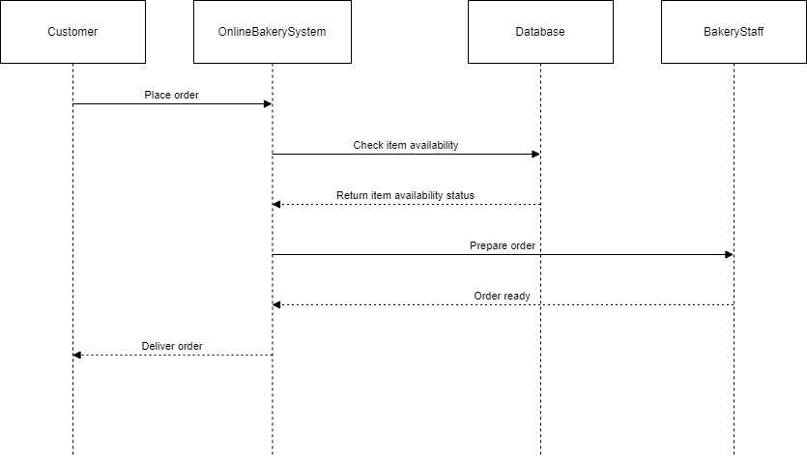
System Design (1)-Sequence Diagram

Slide 10
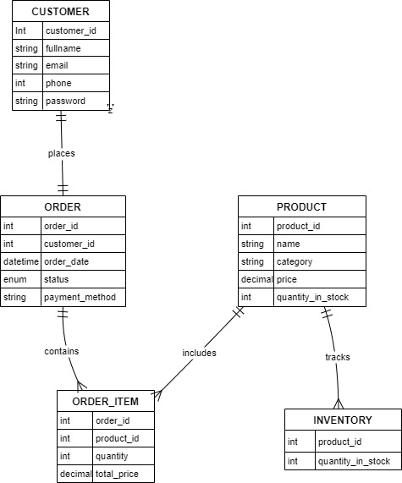
Design(2)-ERD Diagram

Slide 11
Design(3)
Test data
[show an extract, may be test data for one entity)]

Slide 12
Implementation
(In point form indicated work done)

Slide 13
The End
Thank you
[proceed to invite the panel to your system /prototype presentation]

